Slide 1
Final Project:
Q-Learning Trading Strategy
STAT 5243: Applied Data Science
MuQing Wen (mw3821)
May 15, 2025
Professor Wang Haiyuan

Slide 2
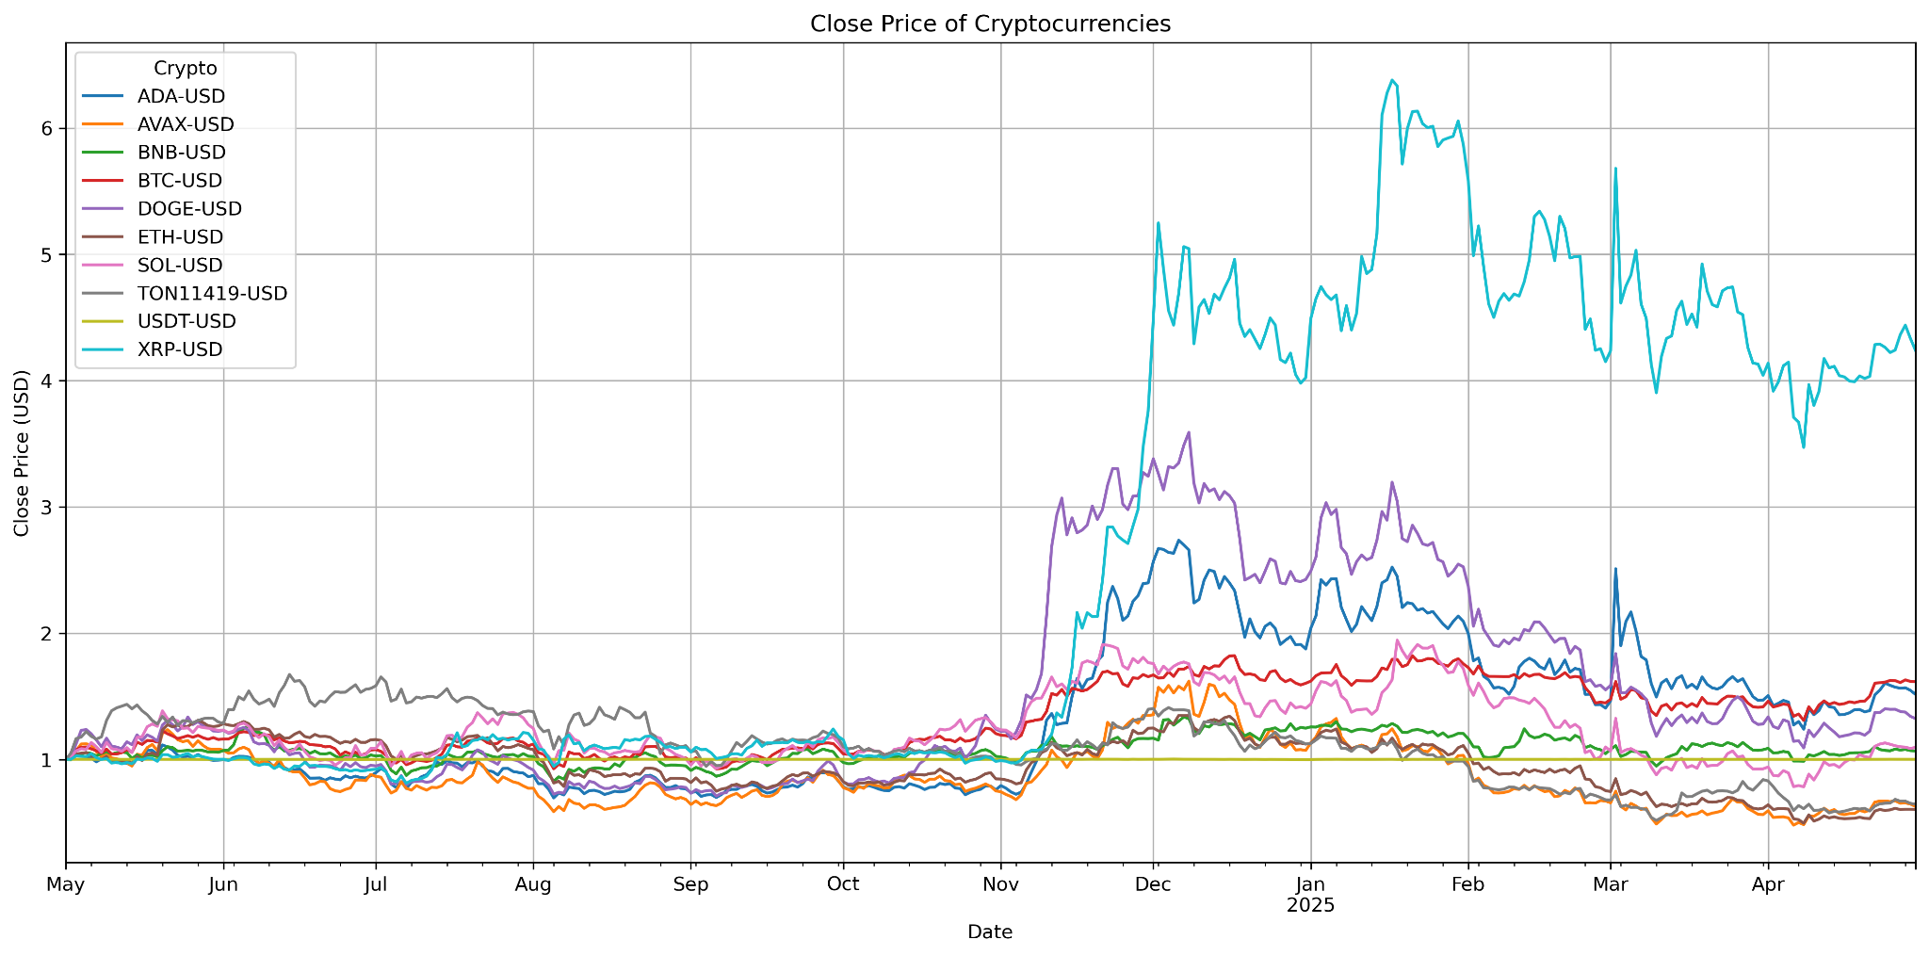
Data Overview: Daily Crypto Price from 2024 - 2025

Slide 3
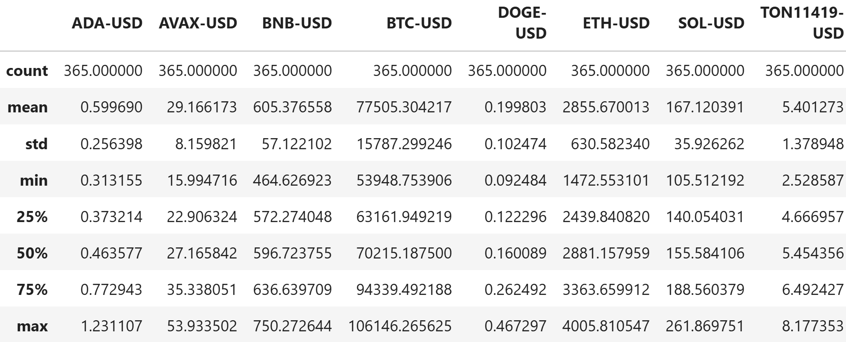
Descriptive Statistics

Slide 4
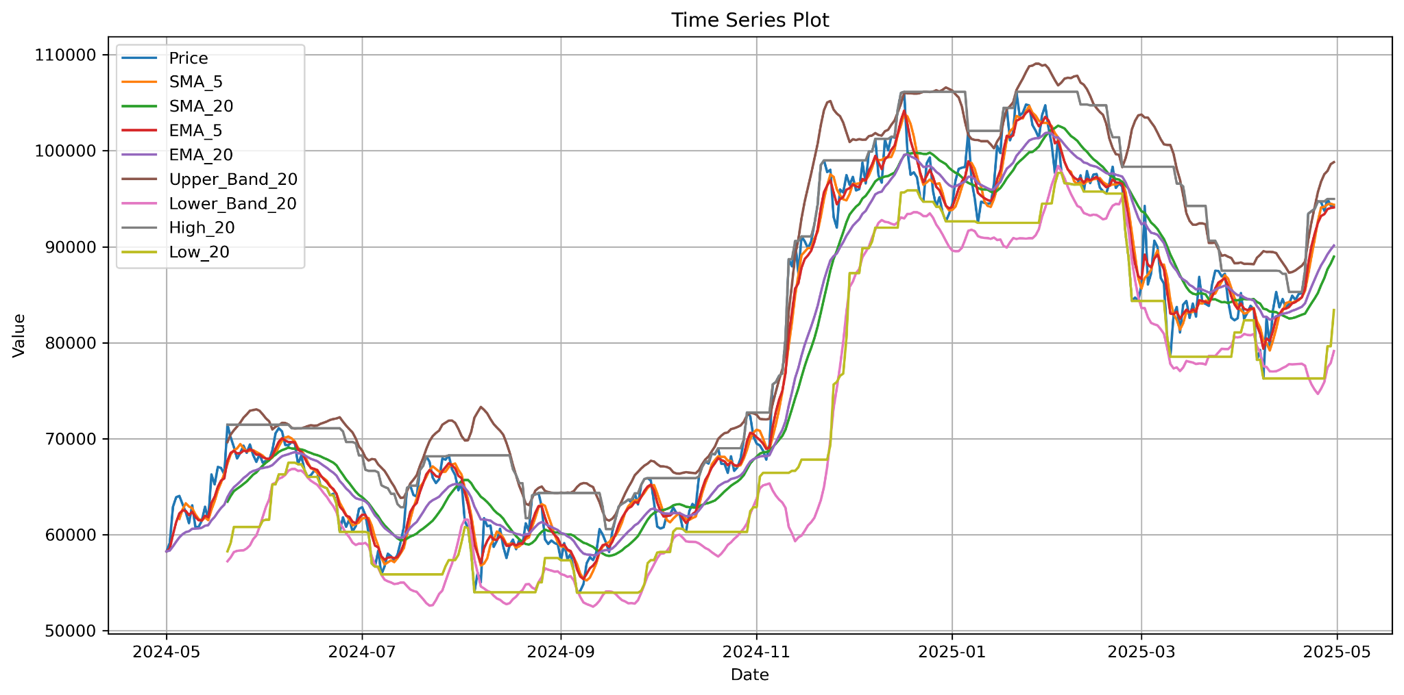
Compute Technical Indicators (SMA, Bollinger Band, 20 Day High/Low)

Slide 5
Sliding Window Forecast
Loop over the data frame in windows of 14 days
Let “Target” be the “Price” of the next day: df["Target"] = df["Price"].shift(-1)
Train the model on the first 13 days and make predictions for the last day
Store the “Date”, “Actual” and “Predicted” values in the “result” data frame
Calculate the R^2 value based on the “Actual” and “Predicted” values
Plot the “Actual” and “Predicted” values on the same plot (visualize predictions)

Slide 6
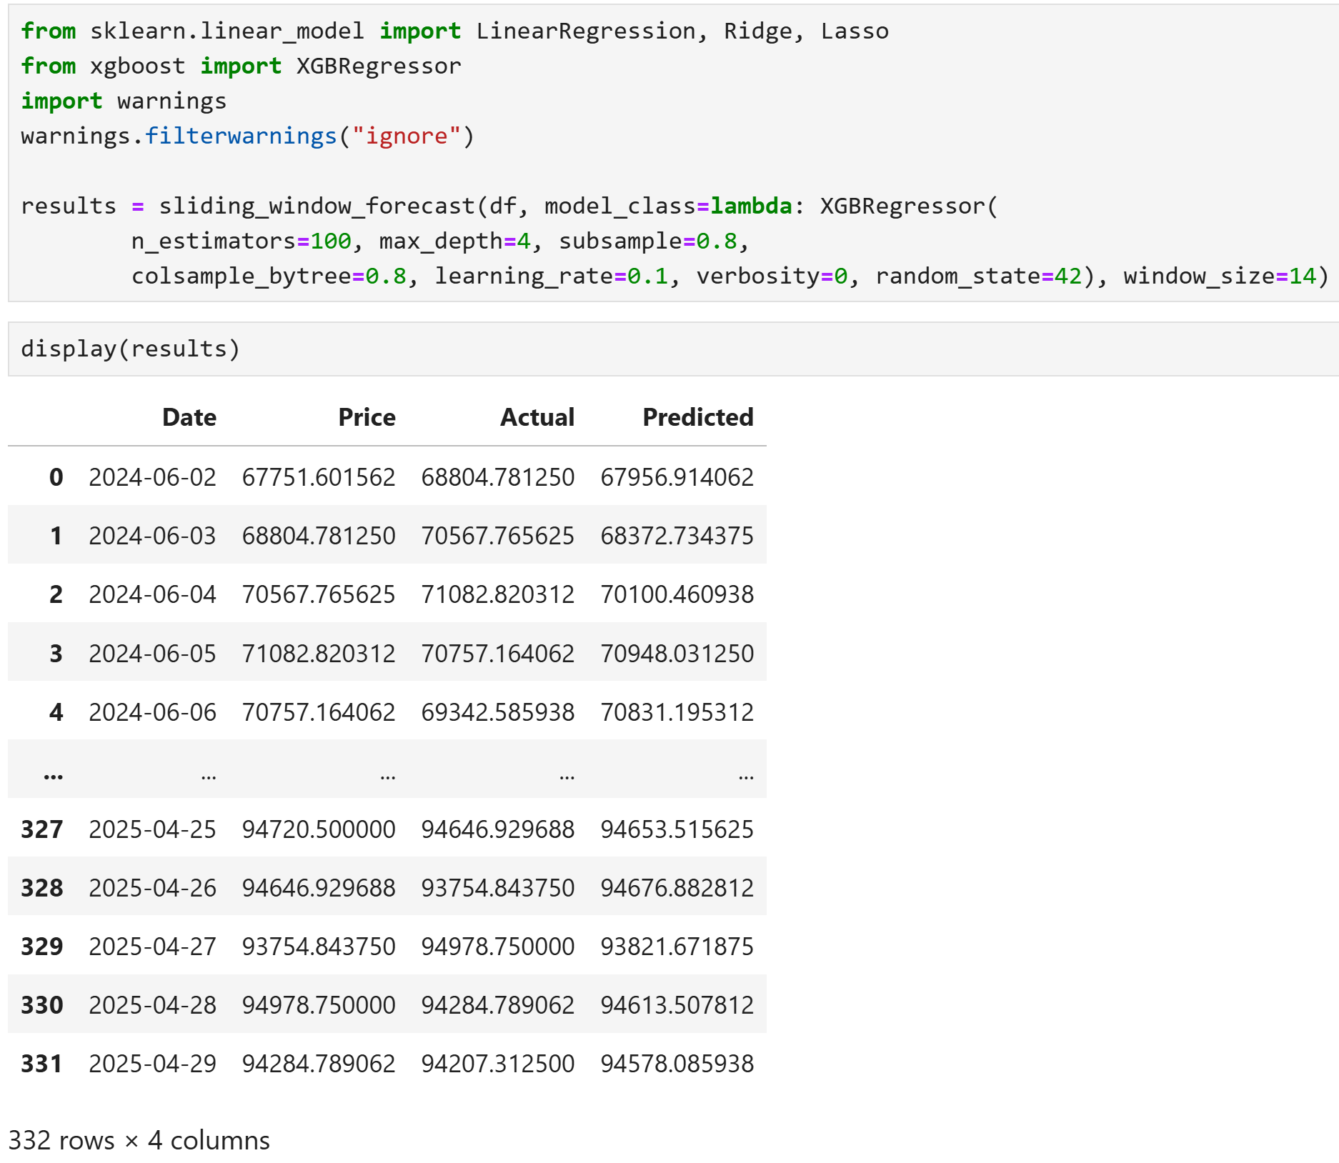
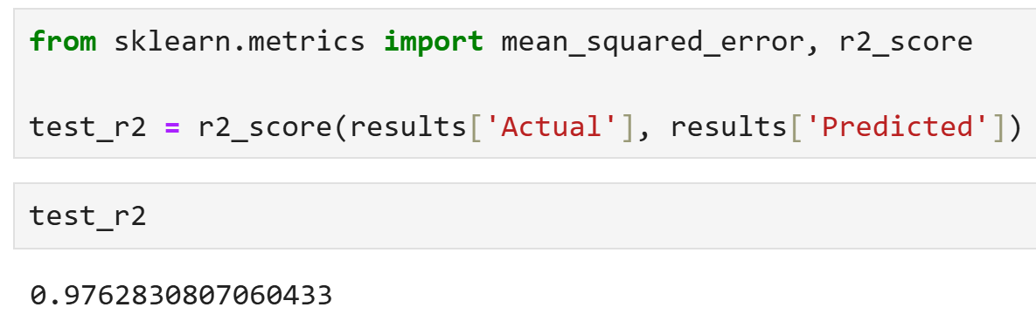

Slide 7
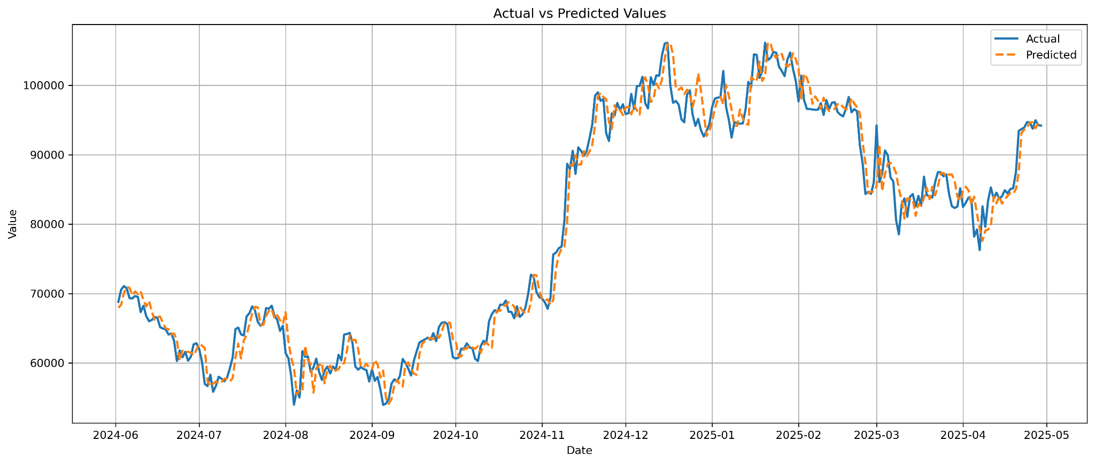
Predicted Next-Day Price from XGBoost: R^2 = 0.97

Slide 8
Trading with 10% cash / 10% asset
Initial Portfolio Setup
Seed money: 10,000 USD
Initial crypto holdings: 0 units
Transaction cost: 1% per Buy/Sell action
Strategy Rules and Constraints
Available actions: Buy, Hold, Sell
Can buy using 10% current cash balance / sell 10% crypto balance per transaction
Maximum 5 consecutive identical actions (cannot Buy/Hold/Sell more than 5 times in a row)
Decision thresholds based on predicted price movements and technical indicators

Slide 9
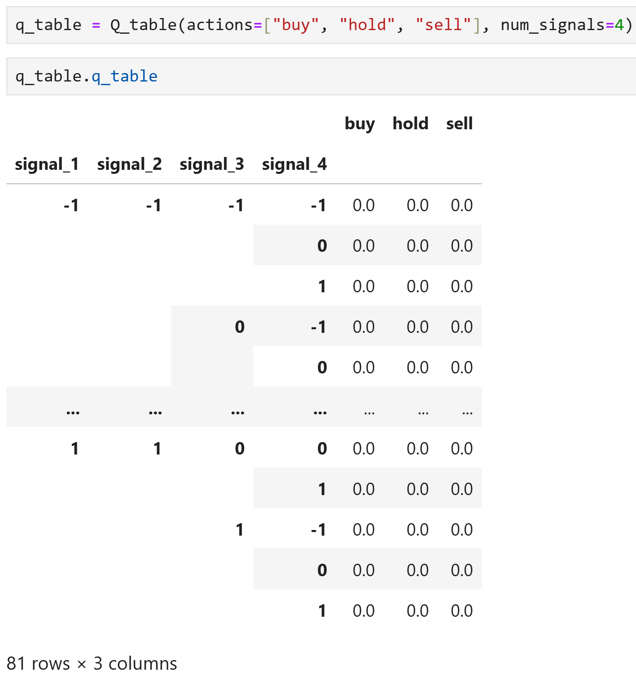
Q-Table
Actions: [“buy”, “hold”, “sell”]
State: Permutation of 4 Signals, each with 3 possible values (+1, 0, -1) = 81 states
Signal_1: Predicted Price Change Direction (+1 when the predicted next-day price is greater than current price; -1 otherwise)
Signal_2: SMA Crossover (+1 for golden cross; -1 for death cross)
Signal_3: High/Low Breakout (+1 when price breaks above the recent high; -1 when price falls below the recent low)
Signal_4: Bollinger Band Breakout (+1 when price moves above the upper band; -1 when price falls below the lower band)

Slide 10
Portfolio
The Portfolio class simulates the trading environment.
It keep track of the current step (current date), current cash balance, inventory (number of coins held), and the repetition counts for each action.
It has functions to calculate the current state (“get_state”) and current portfolio value (by calculating the 4 signals).
It supports buy, sell, and hold actions (update cash and inventory based on current price and transaction cost).

Slide 11
Learning Agent
The Agent class determines the update policy for the Q-table.
It chooses actions using an ε-greedy strategy: randomly select actions with ε probability; otherwise, decide the next action based on the current state and the reward (Q-table).
There are two update policies: SARSA (function “update”) and Q-learning (function “update2”).
SARSA is an on-policy update method that update based on the next action.
Q-learning is an off-policy update method that update based on next action that has the maximum reward.

Slide 12
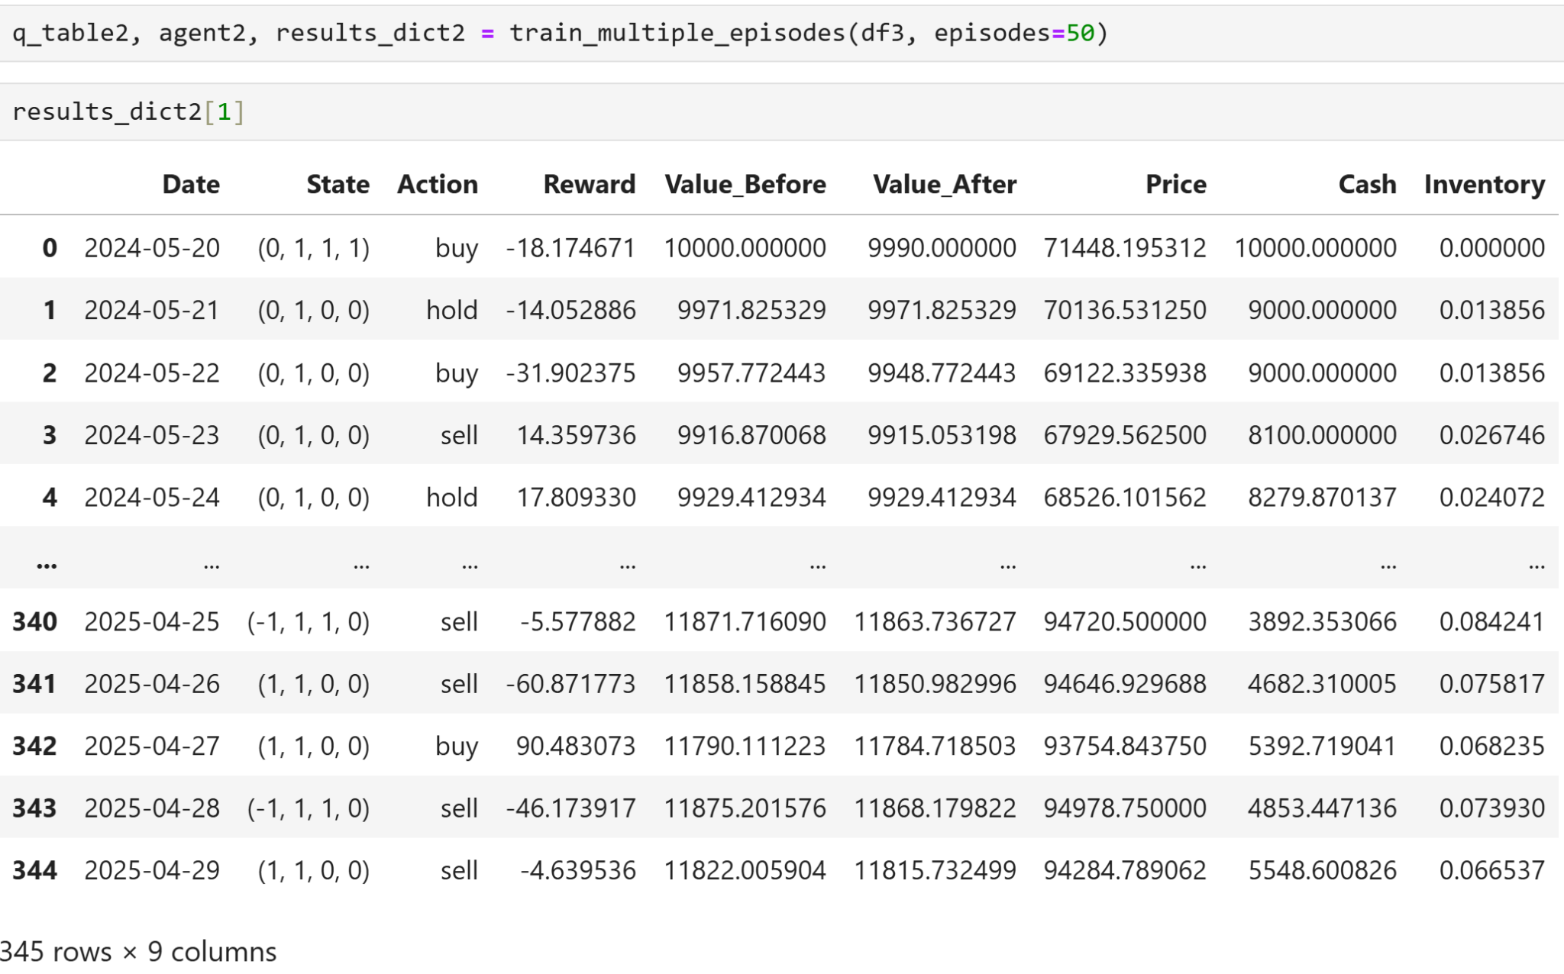

Slide 13
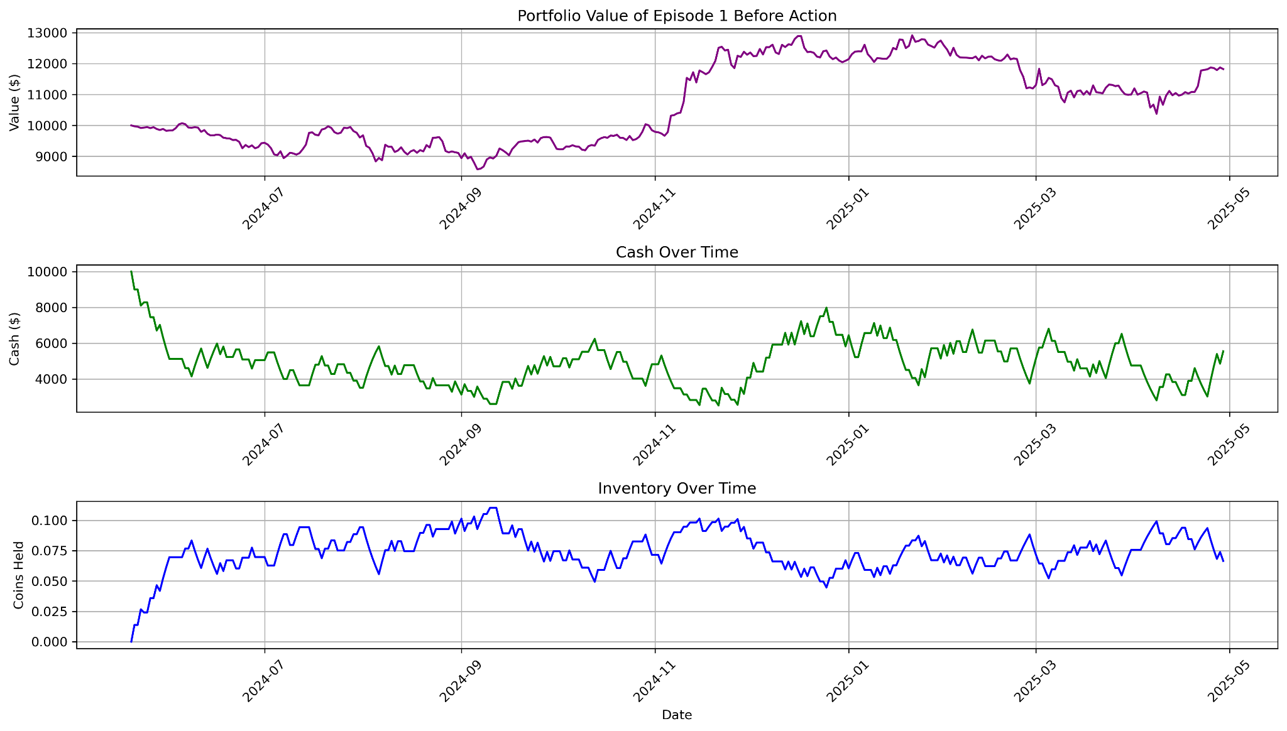
Plot Episode 1

Slide 14
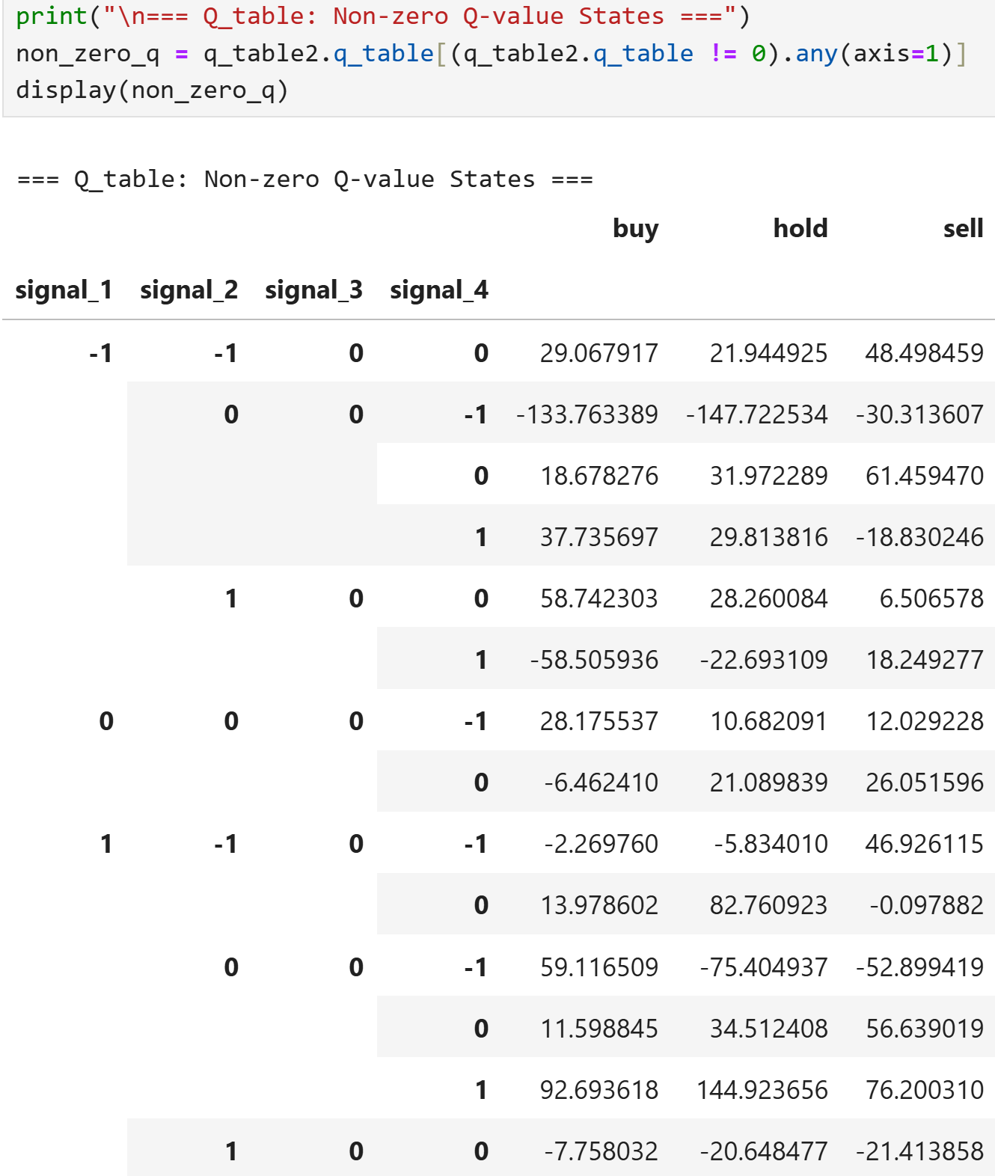
Trained Q-Table

Slide 15
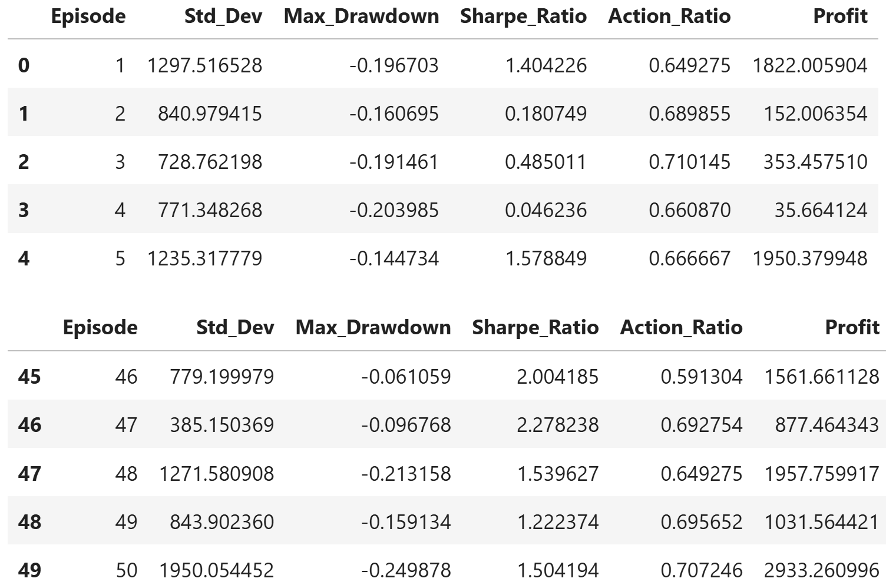
Compute:
Standard deviation
Maximum Drawdown
Sharpe Ratio
Non-Hold Action Ratio
Profit

Slide 16
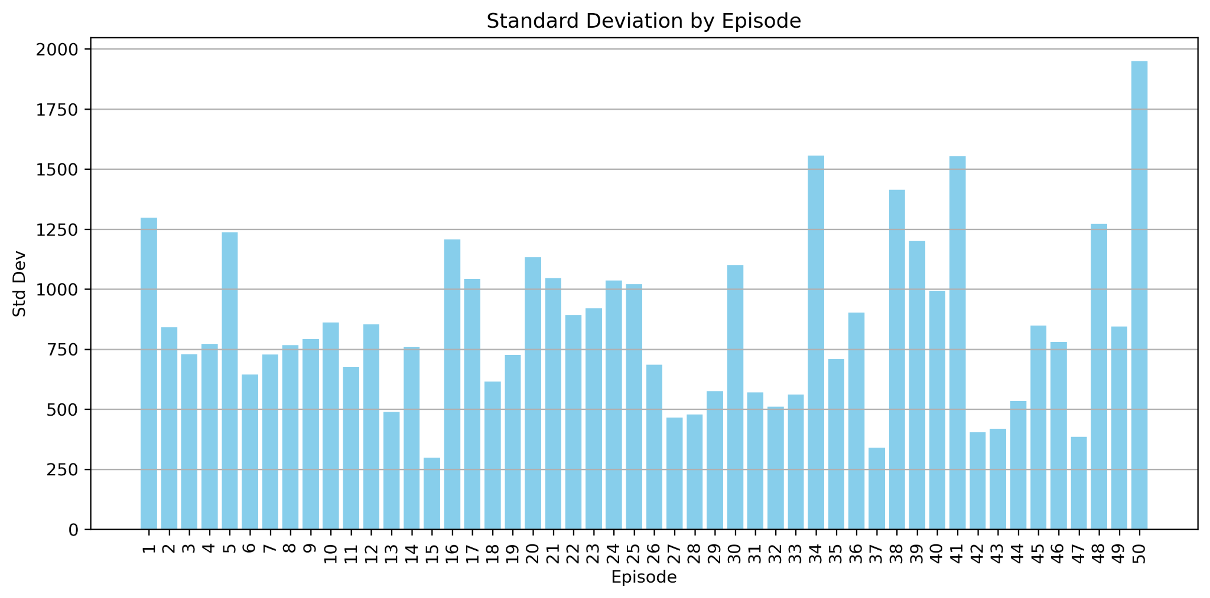
Plot Volatility for each Episode (Task 1)

Slide 17
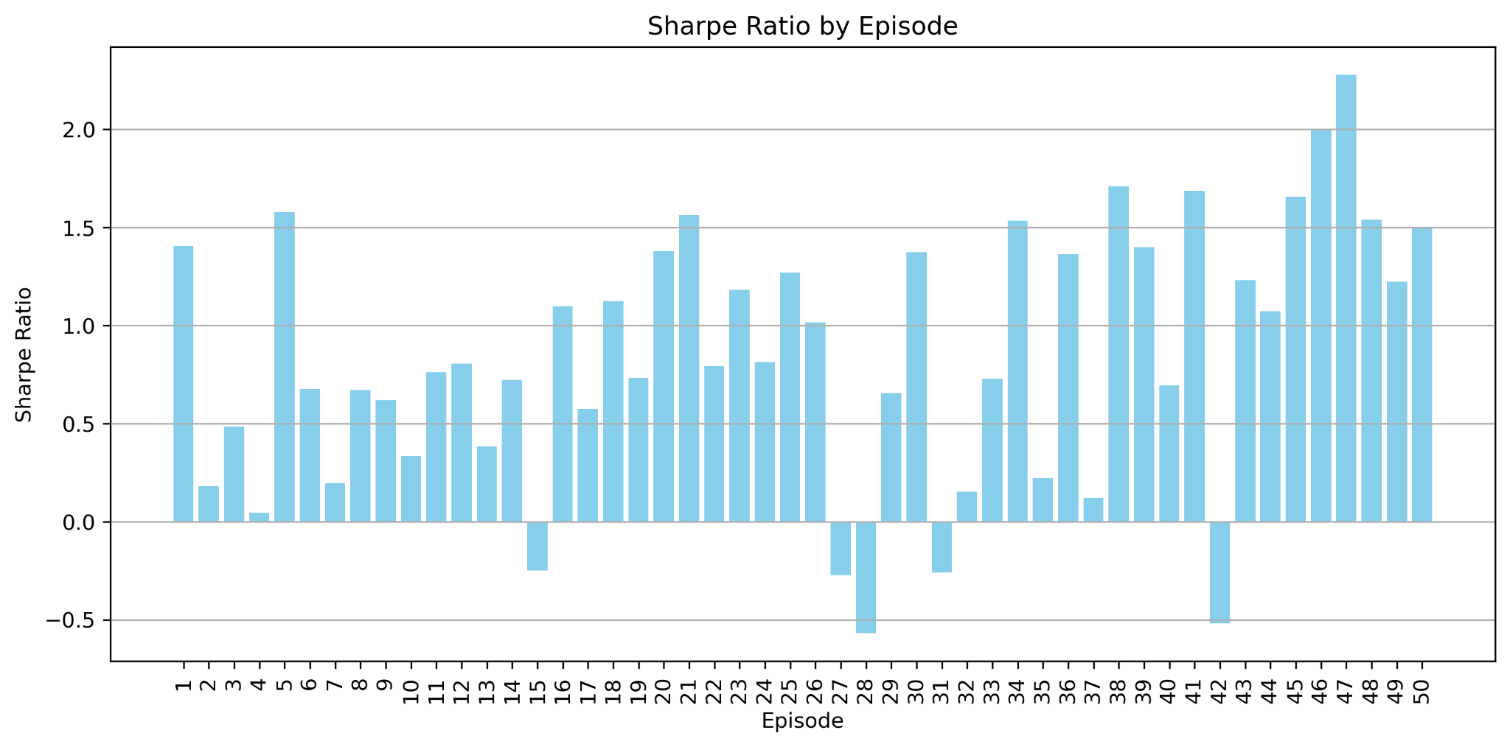
Sharpe Ratio by Episode (Task 1)

Slide 18
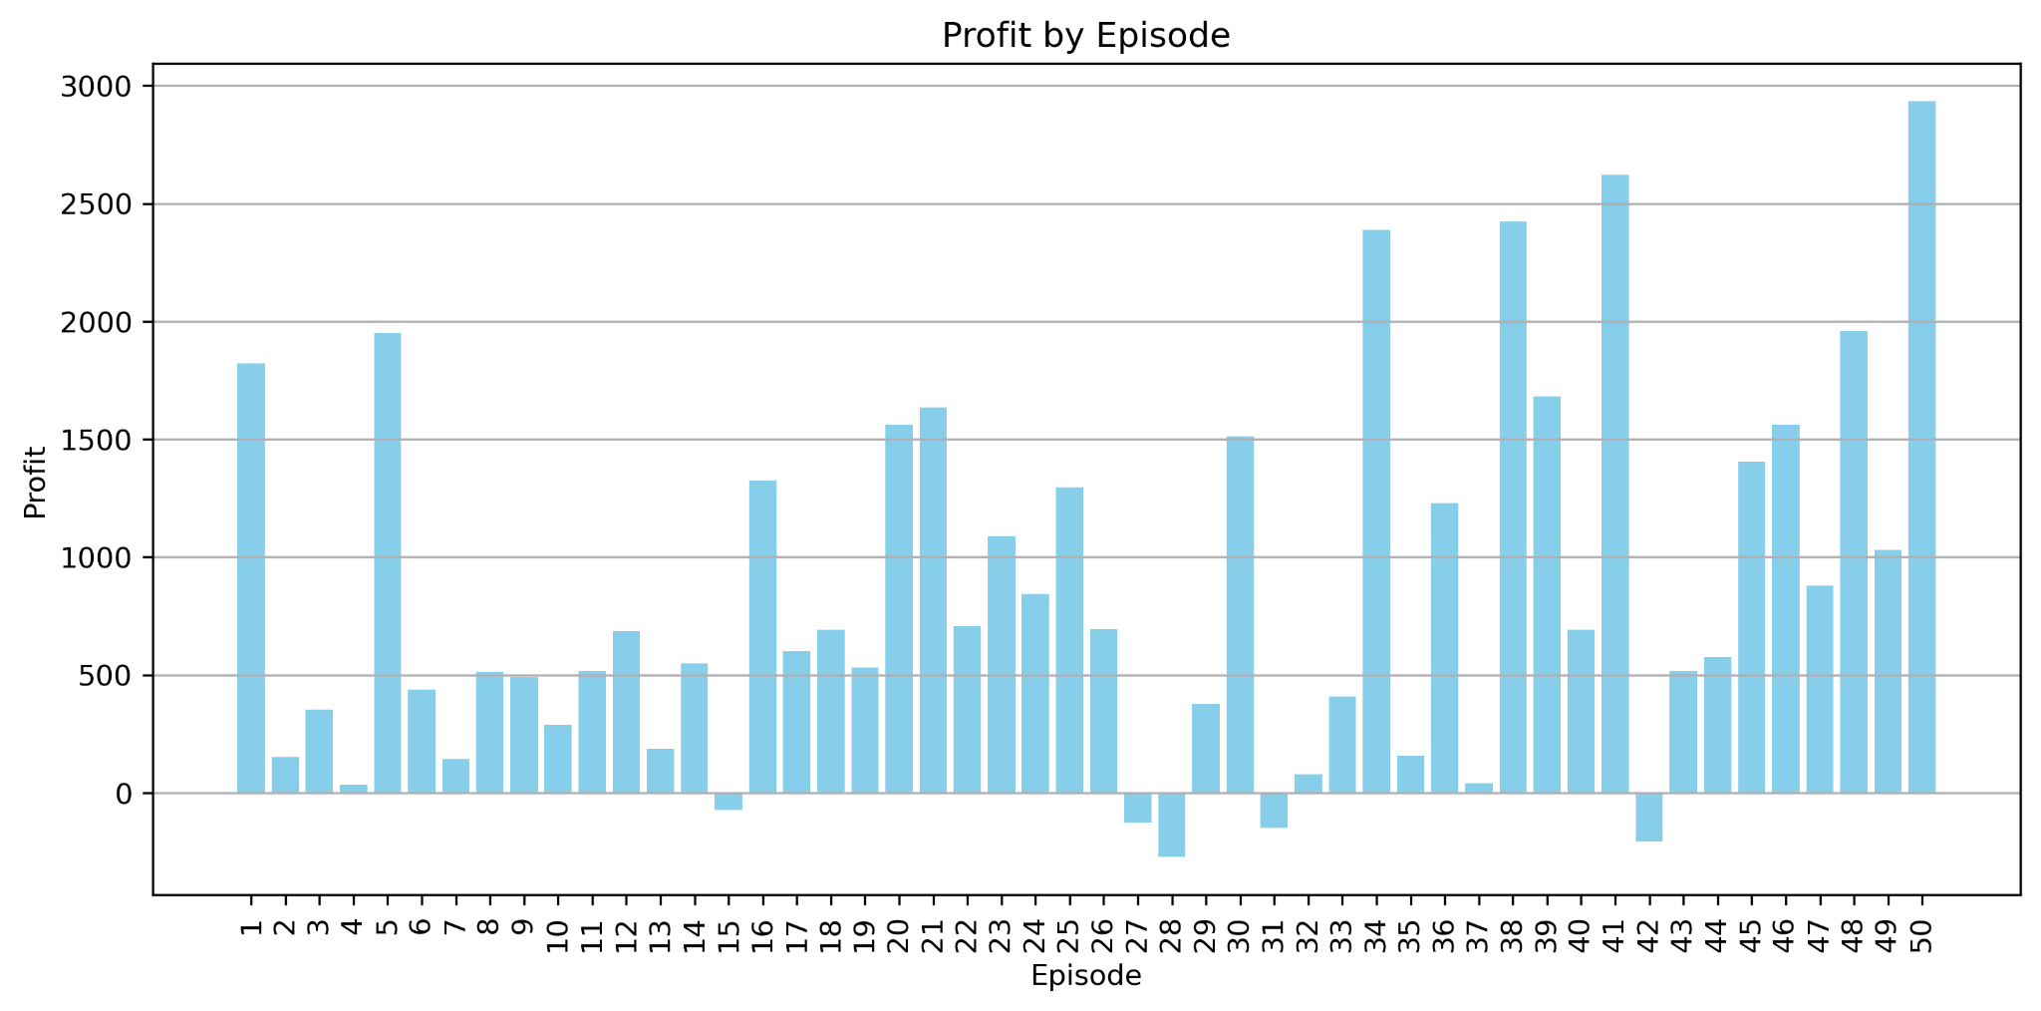
Profit by Episode (Task 1)

Slide 19
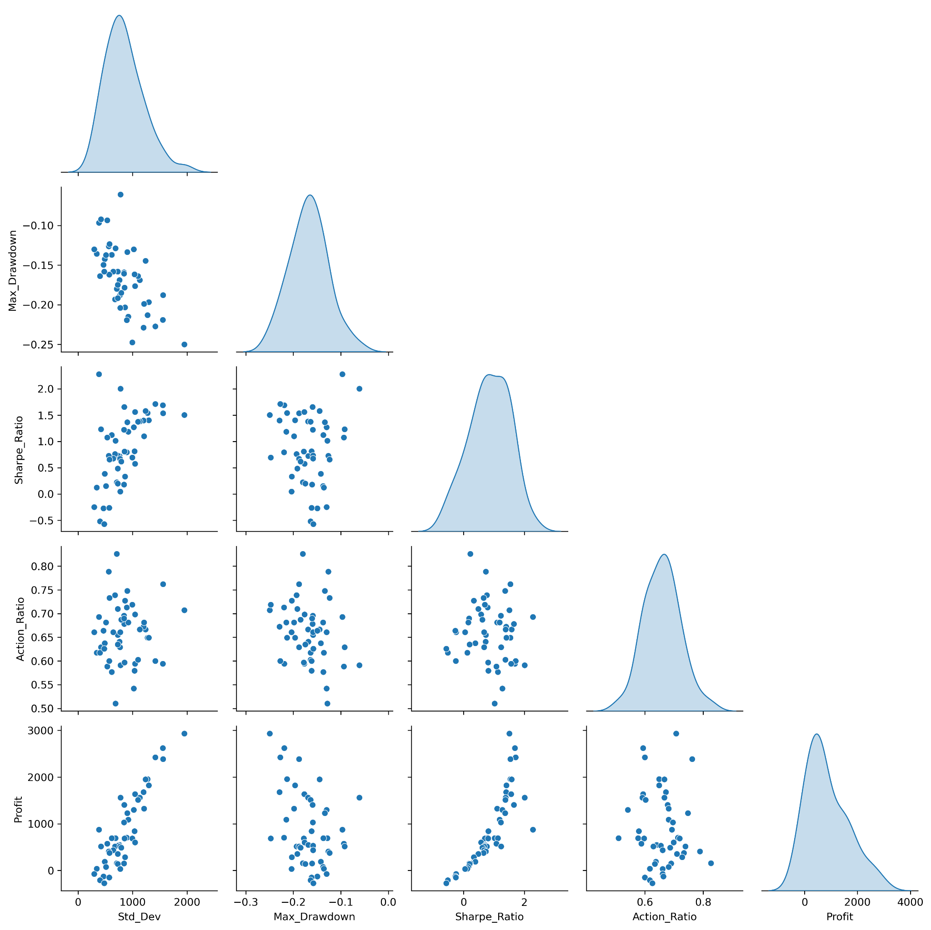
Pattern
High return (Profit / Sharpe Ratio) correlate with higher risk (volatility / standard deviation).

Slide 20
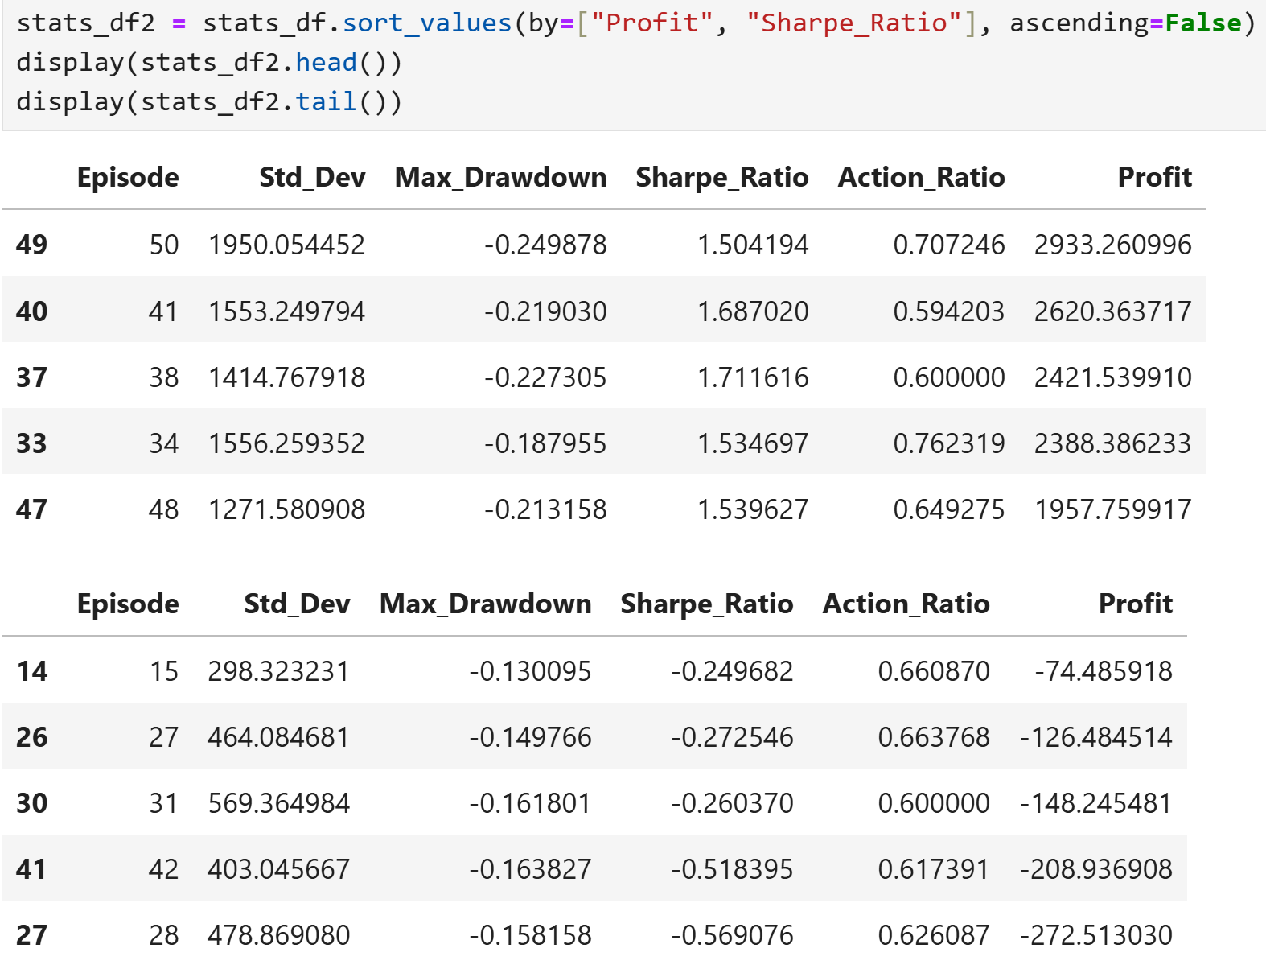
Compare Portfolio with Highest and Lowest Returns

Slide 21
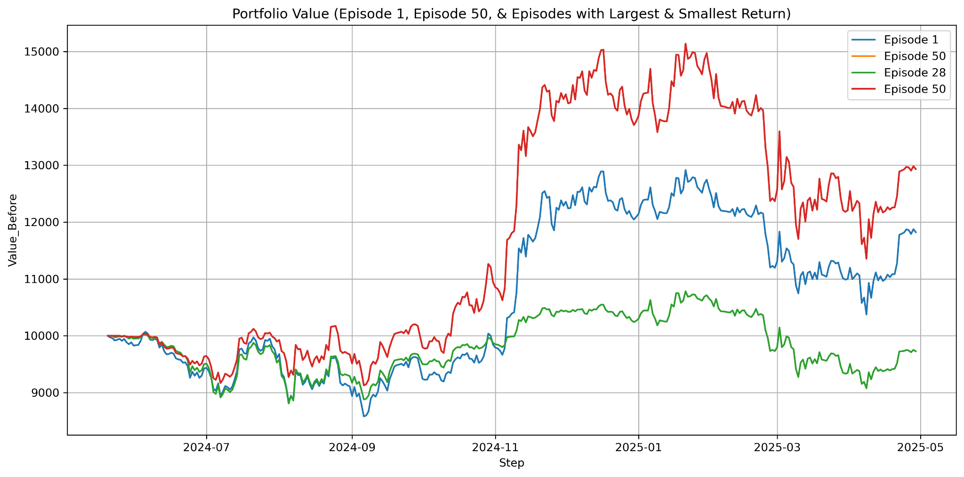
Compare Portfolio with Highest and Lowest Returns

Slide 22
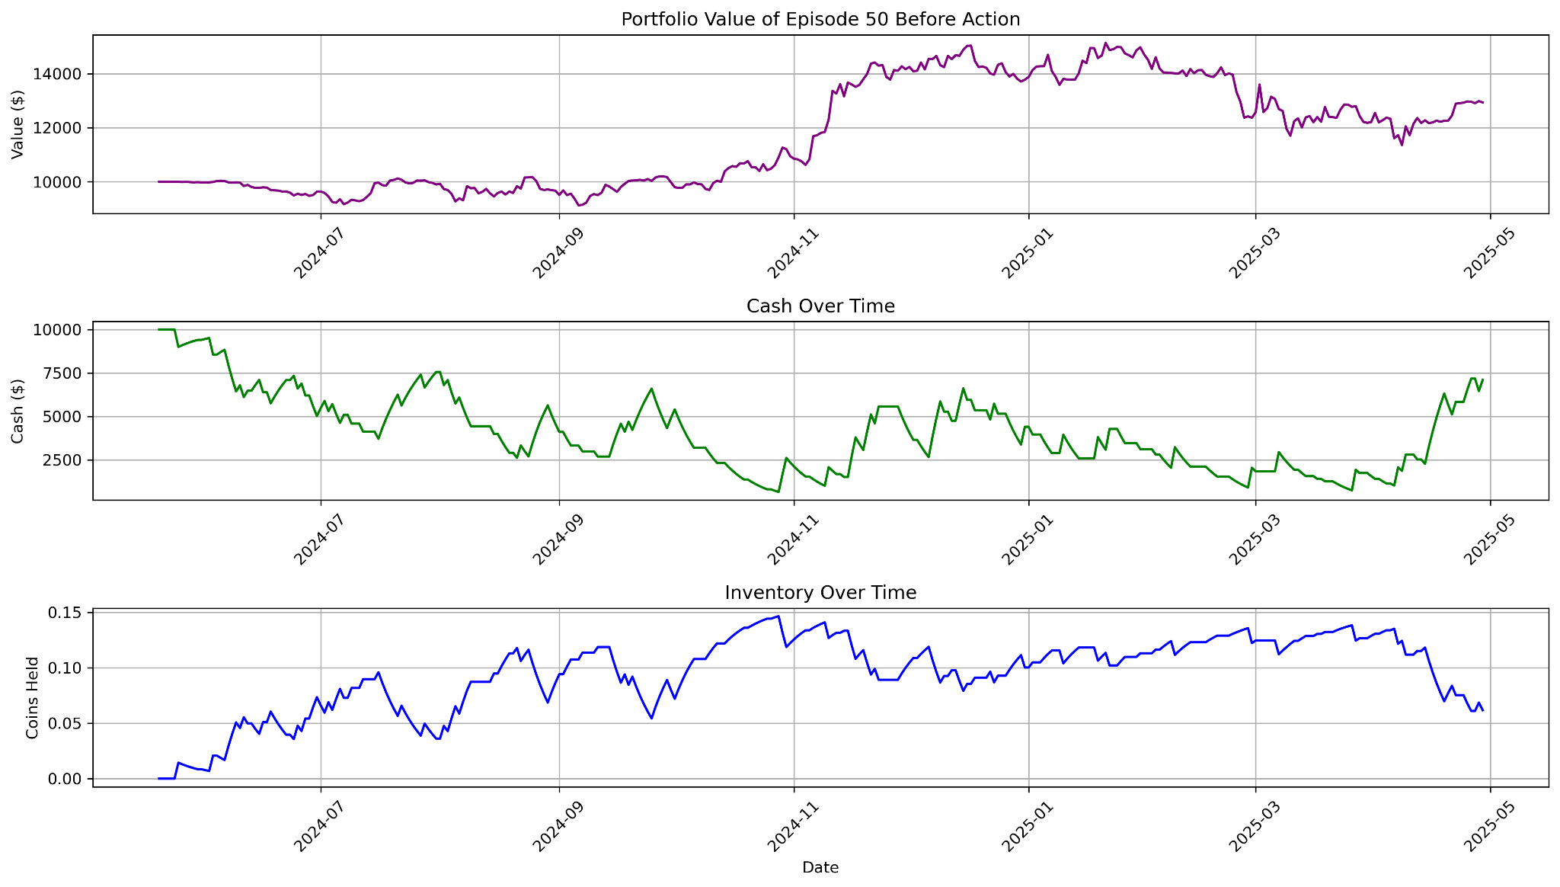
Episode 50: Portfolio with Highest Return

Slide 23
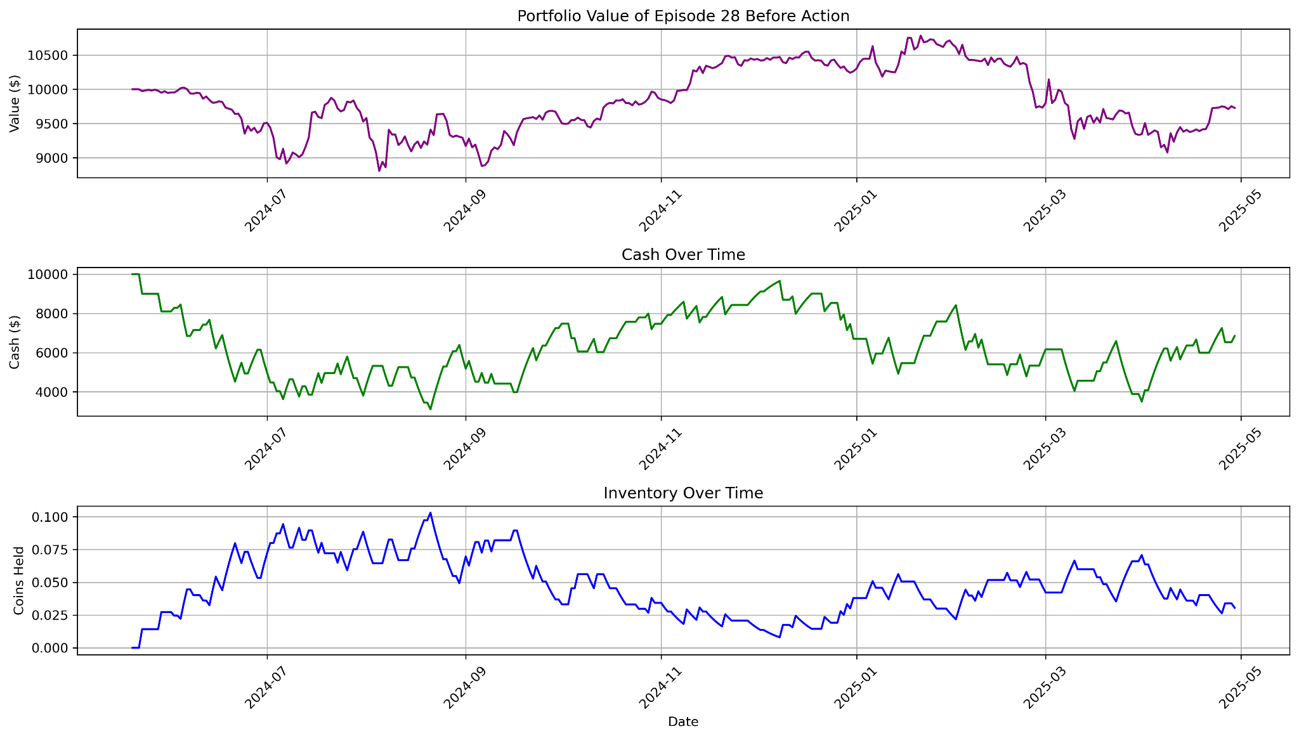
Episode 28: Portfolio with Lowest Return

Slide 24
Conclusion for Part 1
If we want lower risk (lower standard deviation over time), we should sell cryptocurrencies and convert them to cash.
If we want higher return (higher standard deviation), we should buy cryptocurrencies and decrease cash balance.

Slide 25
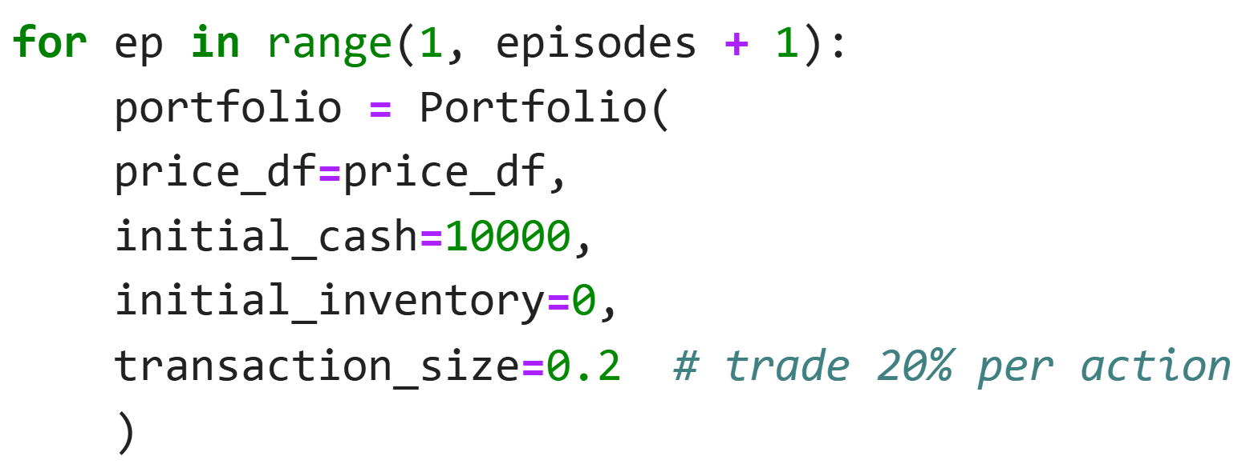
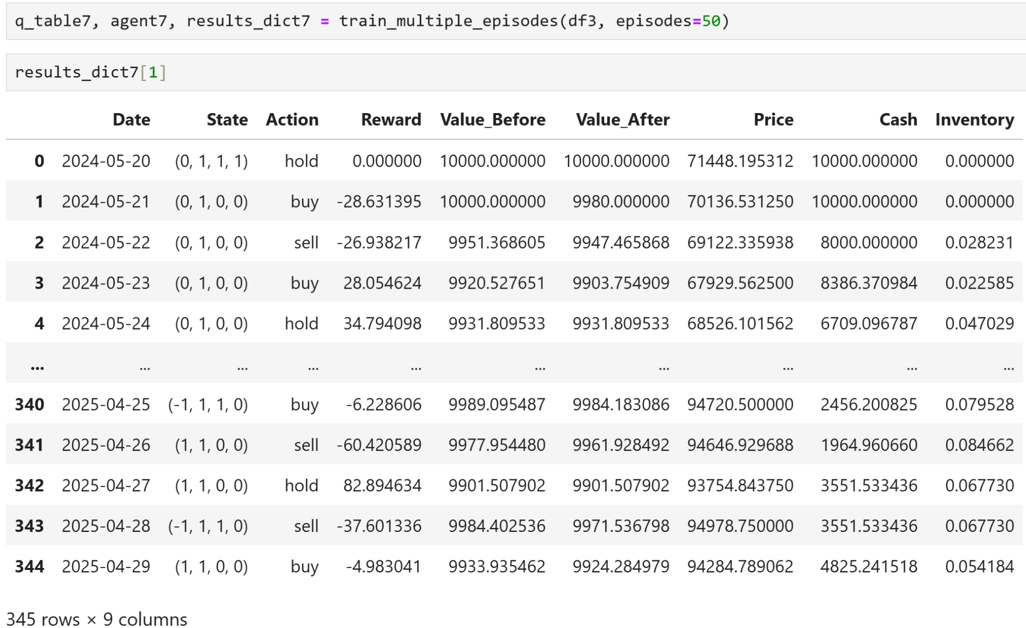
Trade with 20% Cash / Asset

Slide 26
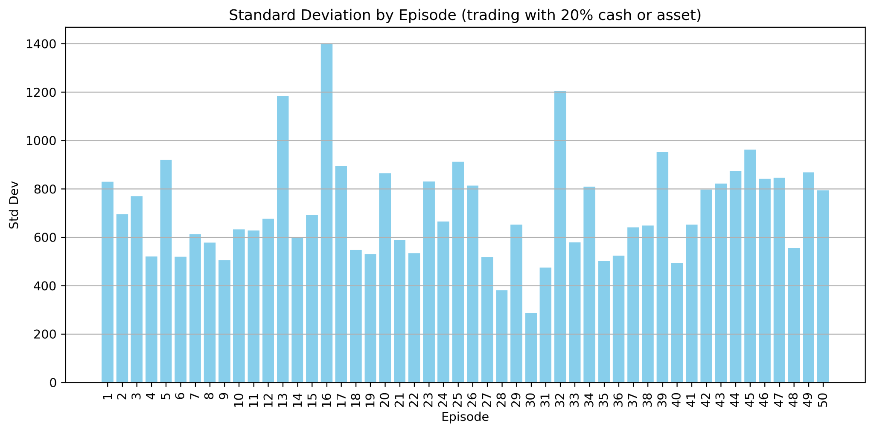
Plot Volatility for each Episode

Slide 27
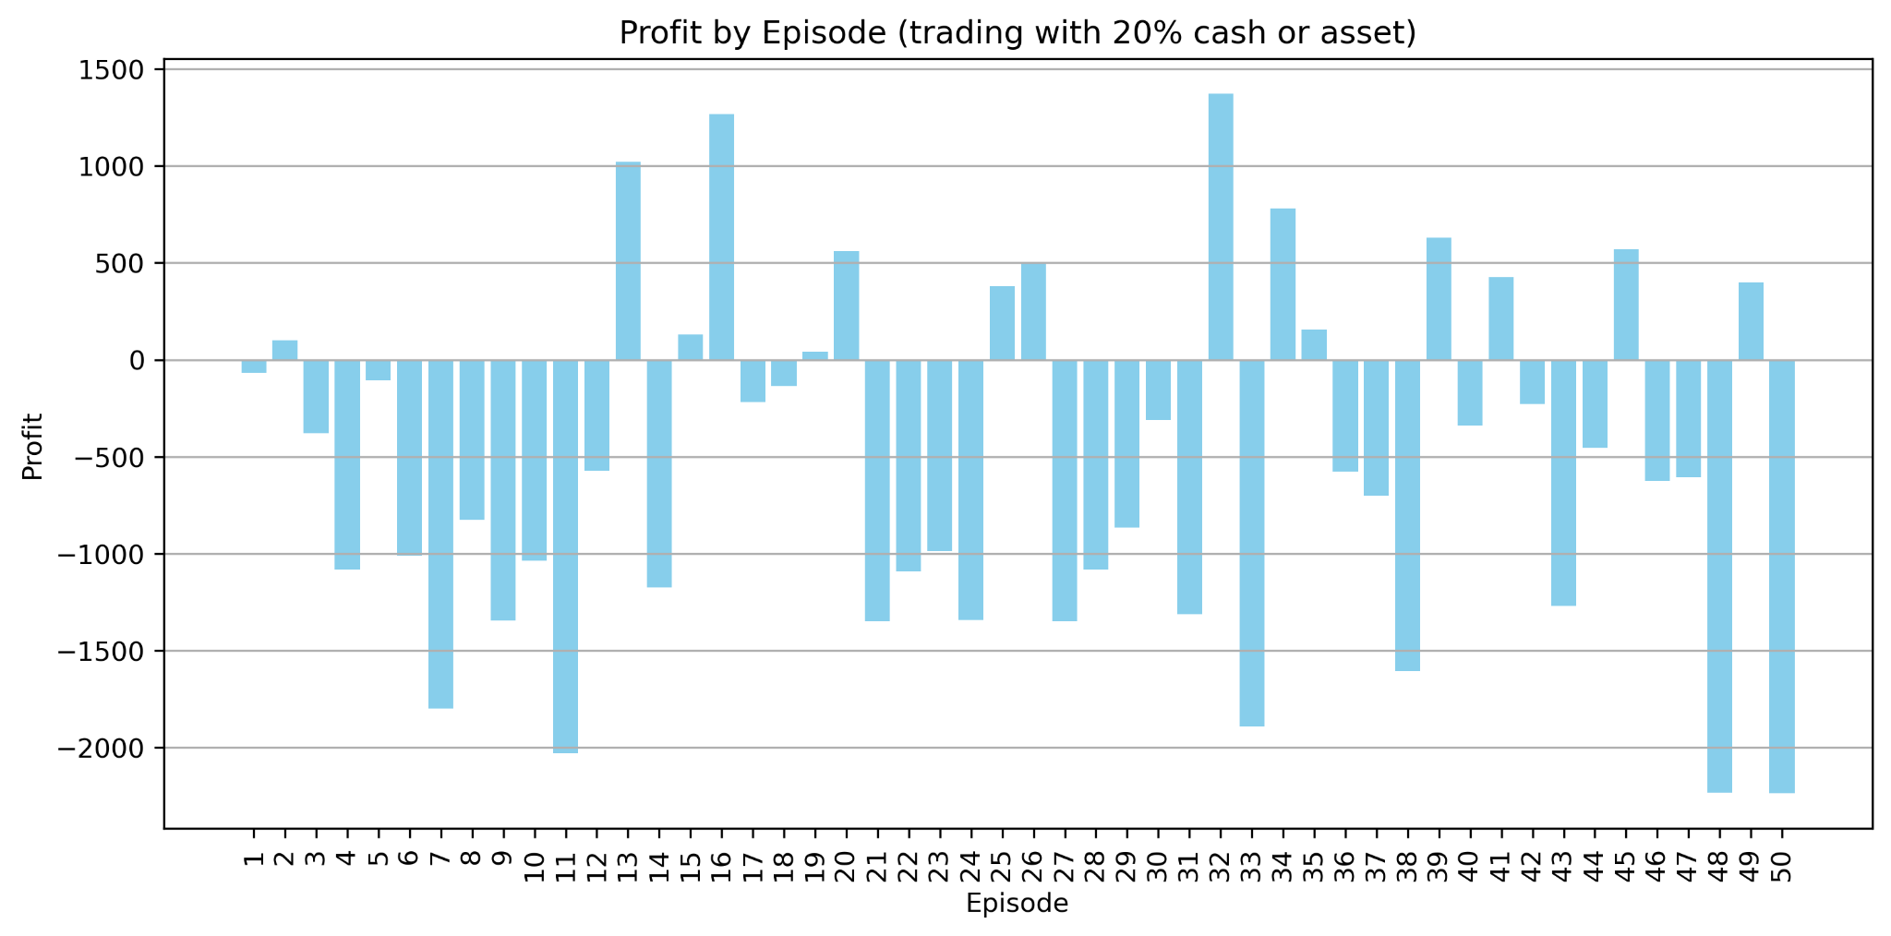
Profit by Episode (Task 2)

Slide 28
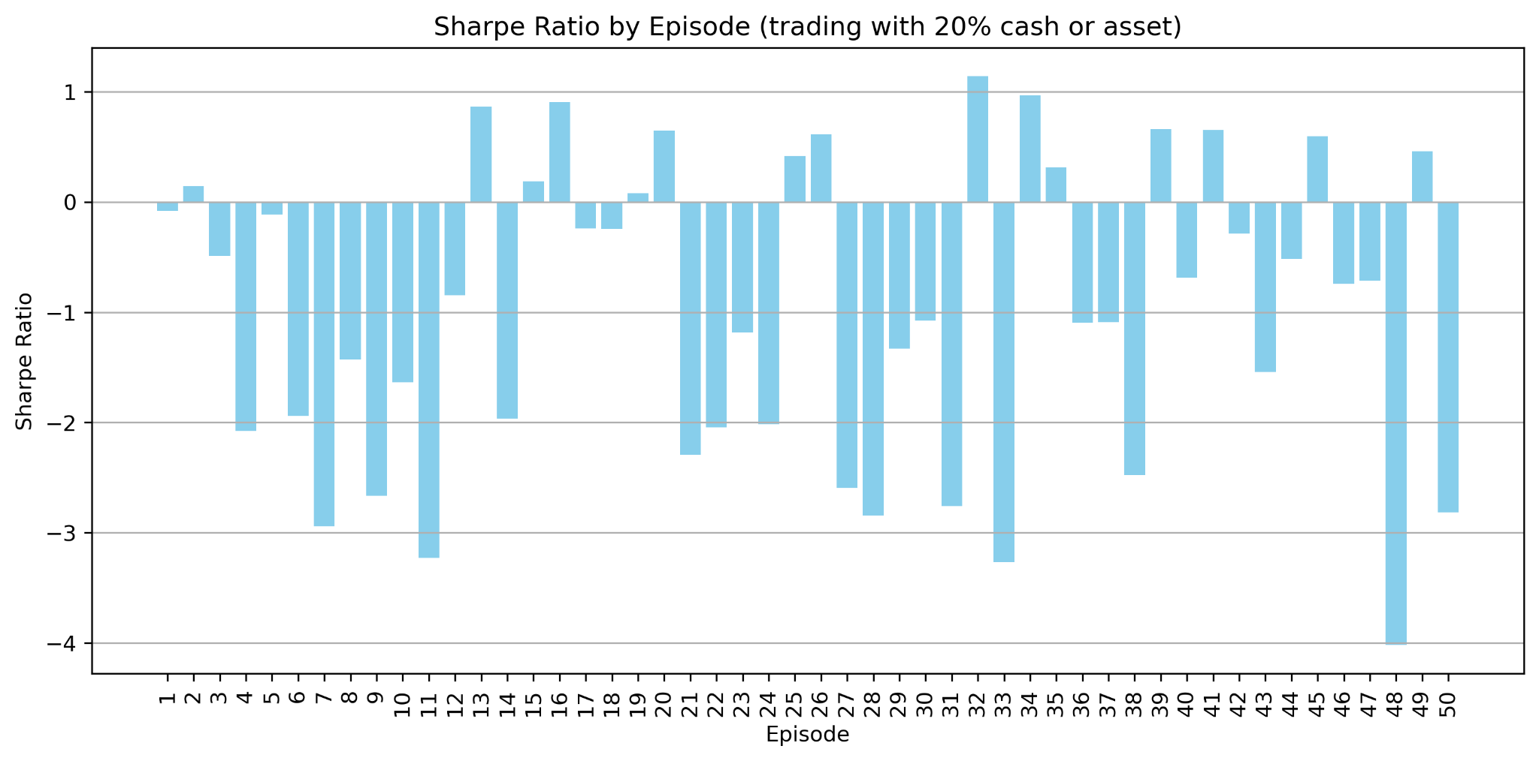
Sharpe Ratio by Episode (Task 2)

Slide 29
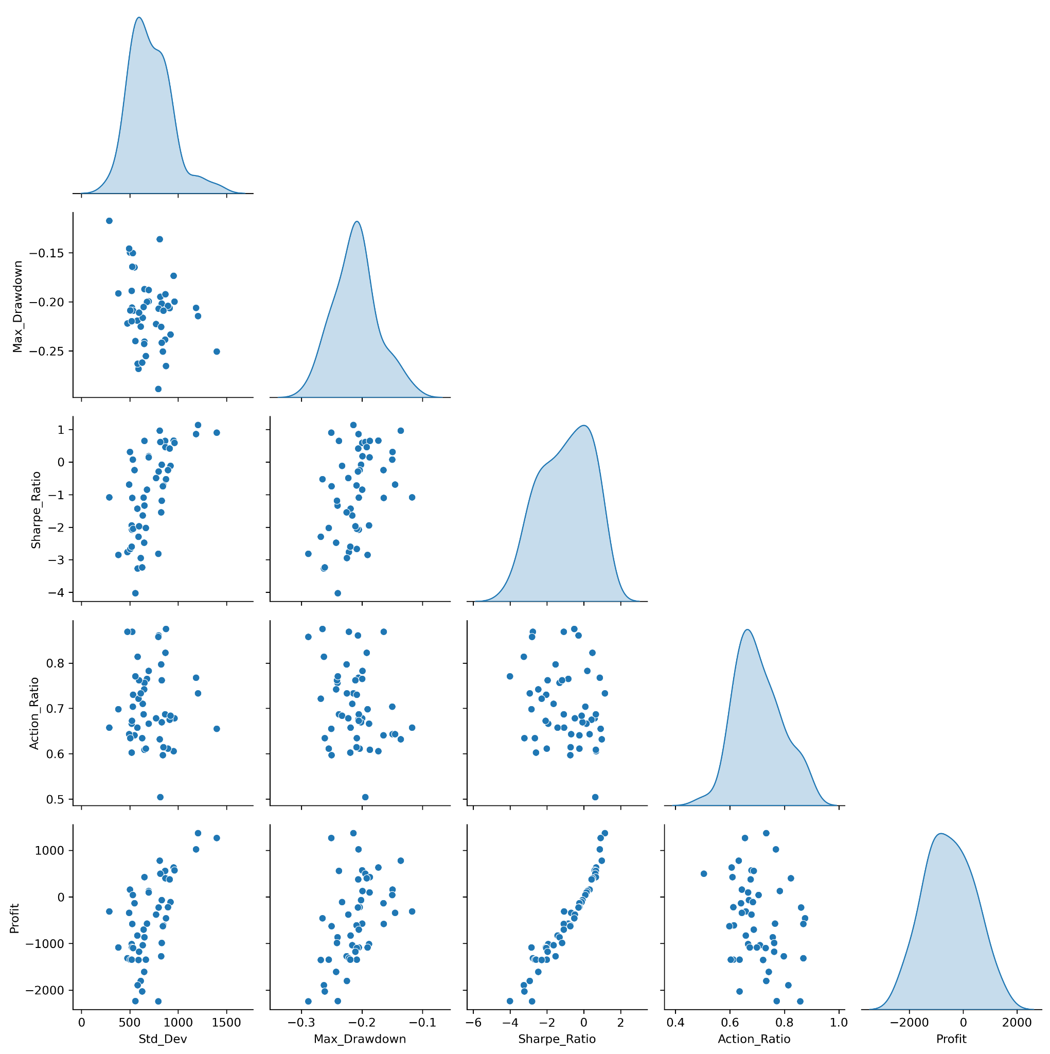
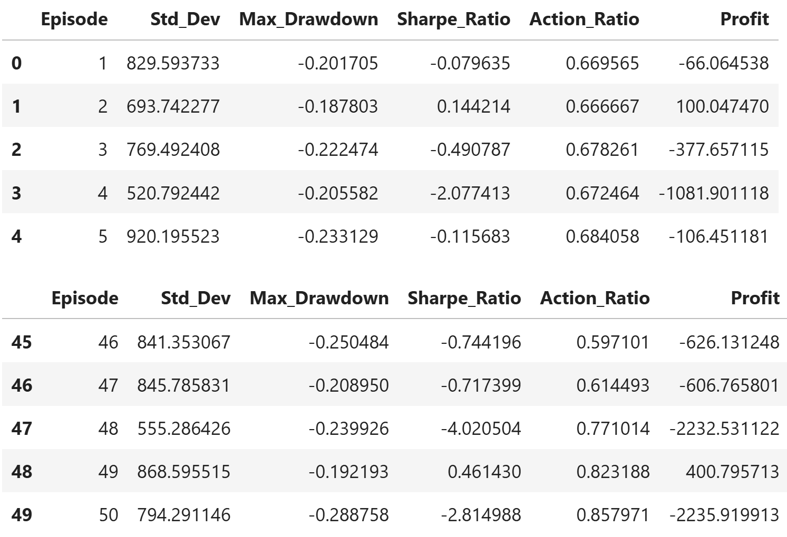
The relationship between volatility and return is less clear.

Slide 30
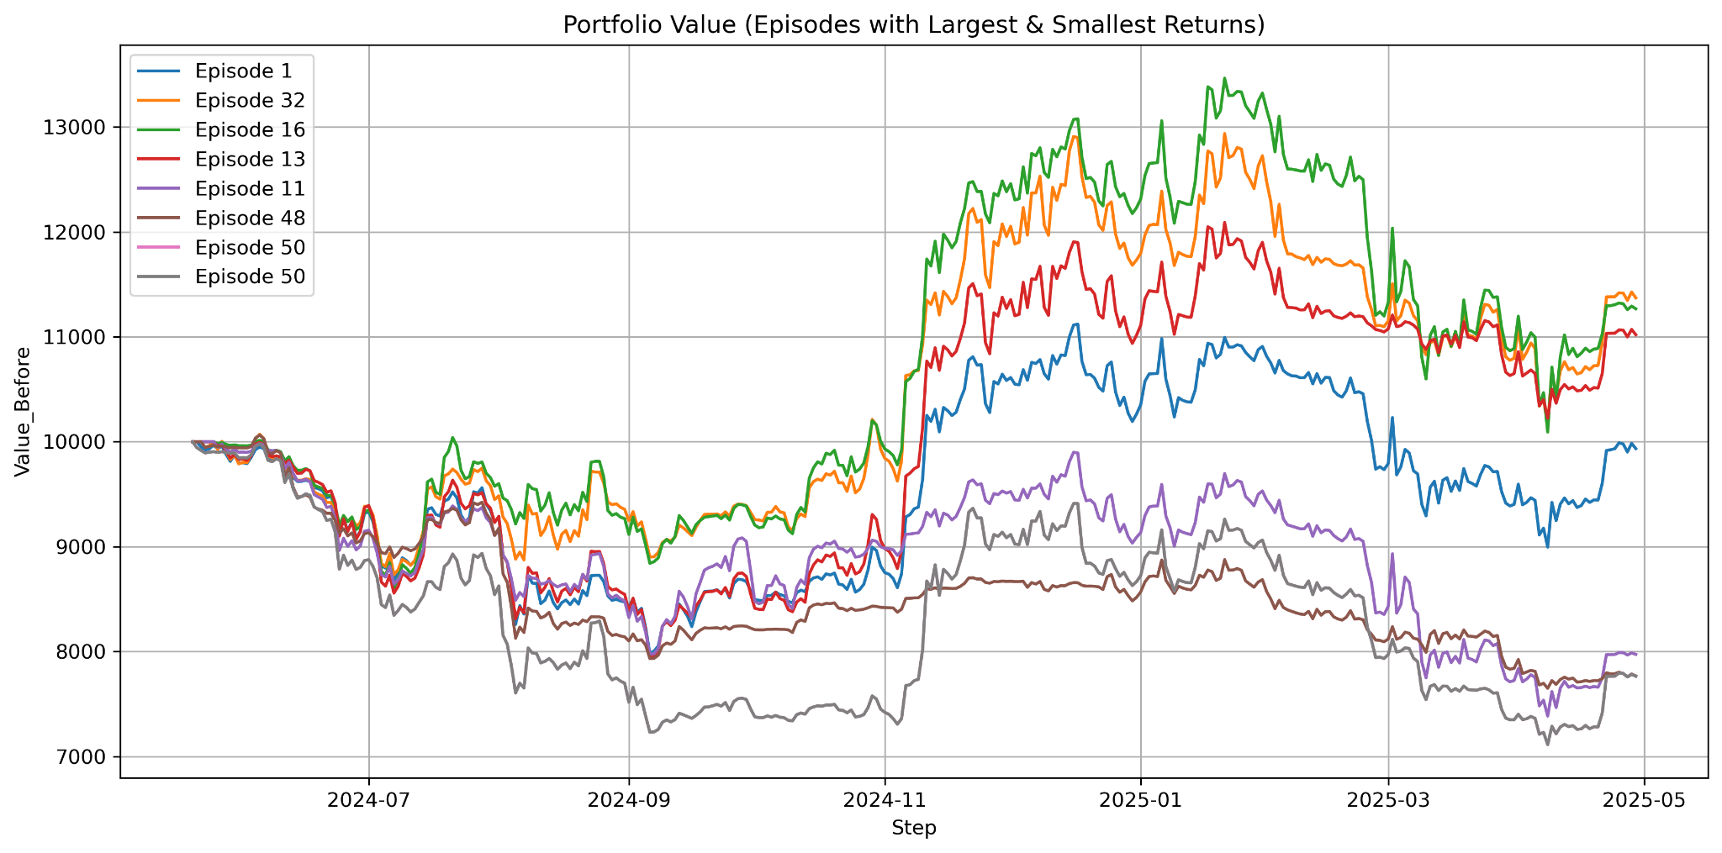
In general, high return is correlated with high volatility

Slide 31
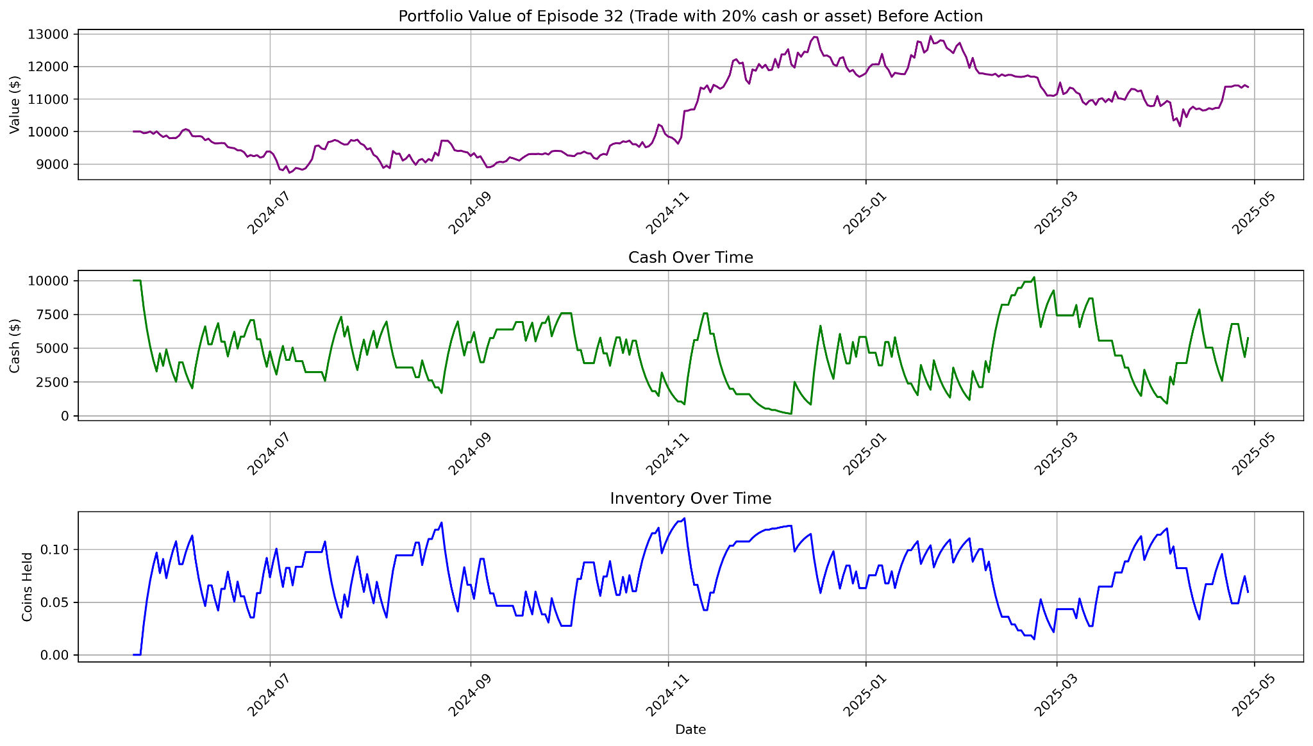
Episode 32: Portfolio with highest return in Part 2

Slide 32
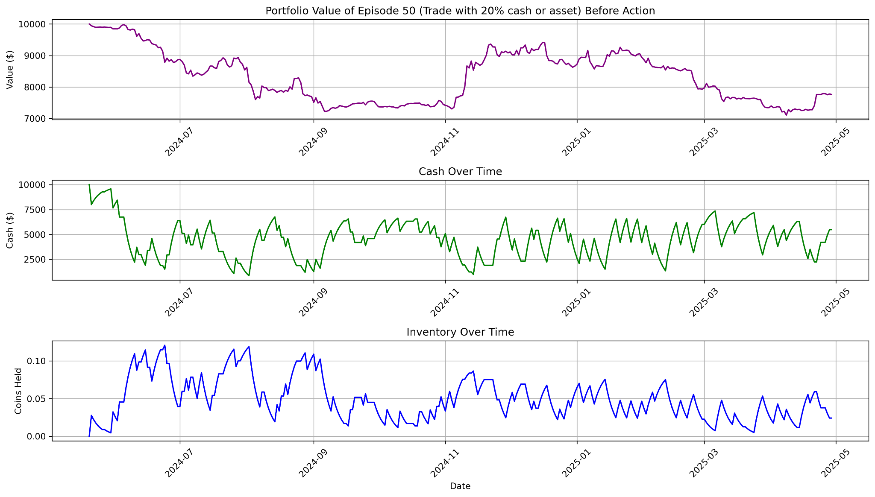
Episode 50: Portfolio with lowest return in Part 2

Slide 33
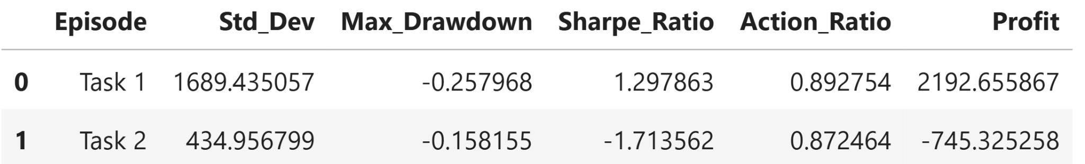
Predict Solely Based on the Trained Q-Table
We observe that the overall profit over the entire period becomes more volatile as we increase the trading volume. Losses occur more often.

Slide 34
Testing the model on different assets
We test the model by applying the same steps on different assets:
Compute the technical indicators (SMA, EMA, Bollinger Bands) based on price of each asset;
Make predictions based on the technical indicators, and store the “price_change_direction” (+1 or -1) in the same data frame as the technical indicators and price — this forms the input data frame, which we store as CSV files in a folder called “input”. There should be a CSV file for each asset.
Loop through the “input” folder, load the csv files into data frames. Divide each input data frame into 80% training set and 20% test set.
Train a Q-table using the function “train_multiple_episodes”, complete 50 training episodes for each training set.
Test the training result using the function “test_with_greedy_policy”, which would take the test set as input, choose actions entirely based on the trained Q-table (chose the action that has the greatest reward given the current state), and store the result table as a csv file in the “training_result” folder.
Each csv file in the “training_result” folder should contain the dates, chosen action on each date, portfolio value before and after the action, price of the asset, cash, and inventory. We plot them and analyze the result.

Slide 35
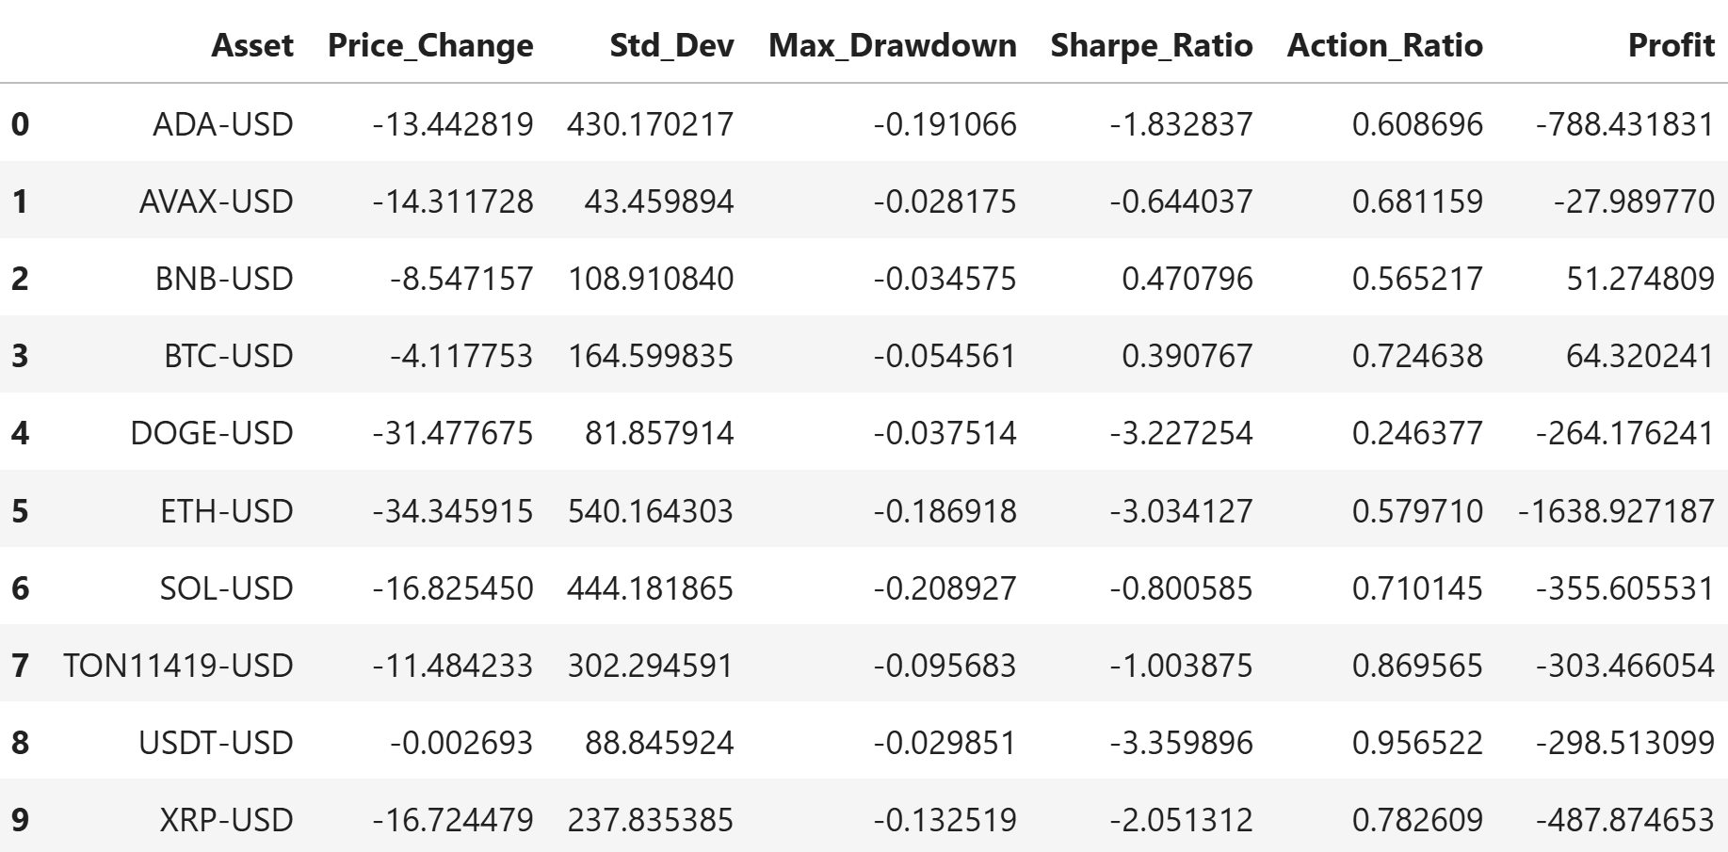
Test result for Different Assets
After computing some basic statistics for each of the training results, we noticed that most of the assets did not result in positive return (“Profit”) during this period under this trading strategy. This is likely because most of the assets experience a negative price change during this period. We observe that BTC resulted in the highest profit and ETH resulted in the lowest profit.

Slide 36
Conclusion
Our results show that the Q-learning framework is capable of learning meaningful trading policies through repeated interactions with a simulated environment. The agent successfully updated its Q-table based on daily portfolio returns and demonstrated improved decision-making across episodes. Nevertheless, the profitability of the strategy varied significantly depending on the asset, the market trend, and the time frame. Assets with declining prices generally produced negative profits. We tested larger trade volume in hope for greater profit, but they only led to higher volatility and more frequent losses.
Overall, this project confirms that reinforcement learning can be a powerful tool in financial trading. However, it also reveals the limitations of applying a fixed-state, discrete-action Q-learning model in a highly dynamic, noisy market like cryptocurrency. The agent's performance is heavily dependent on the quality of the input signals, the stability of market trends, and the design of the reward structure.

Slide 37
Future Work
Several directions can be explored to improve the performance, robustness, and generalizability of this approach:
Experiment with different signal-states, try to figure out which signals can affect profit the most.
Update the Q-table during the testing period: Update the Q-table dynamically during the test period, try to assign different weights to rewards during the testing period.
Try to build the Q-table only on episodes with the most overall profit.
Try different combinations of assets instead of one asset at a time.

